Slide 1
UsER Interface PROTOTYPE project Phase II
Prepared by Elementary Engineers:
Olga Sheehan, Sara Hakkoum,
Eric Holm, Ethan Fiero
Framingham State University
2016

Slide 2
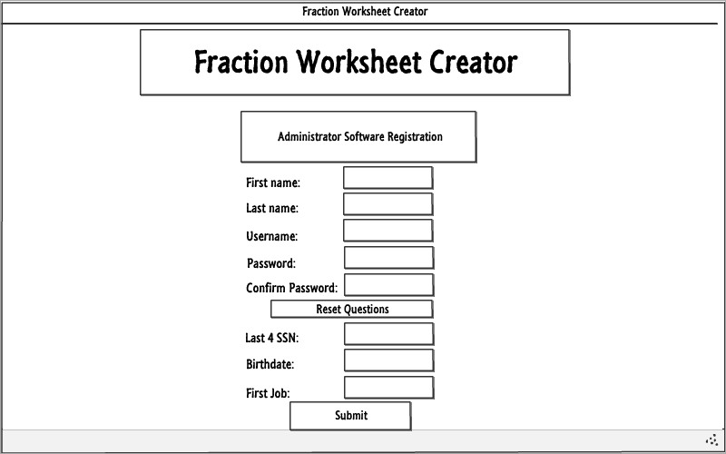
Admin Software REGISTRATION

Slide 3
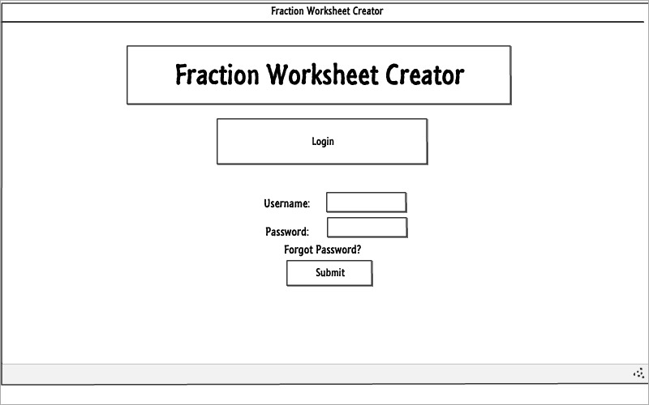
LOGIN

Slide 4
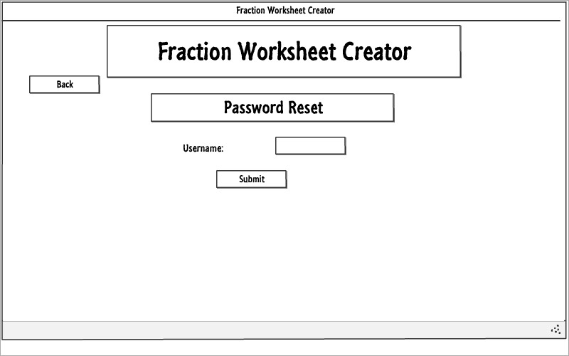
USER FORGOT the password

Slide 5
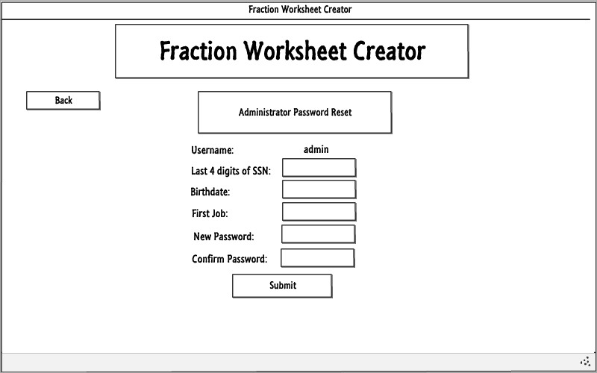
Administrator Password reset

Slide 6
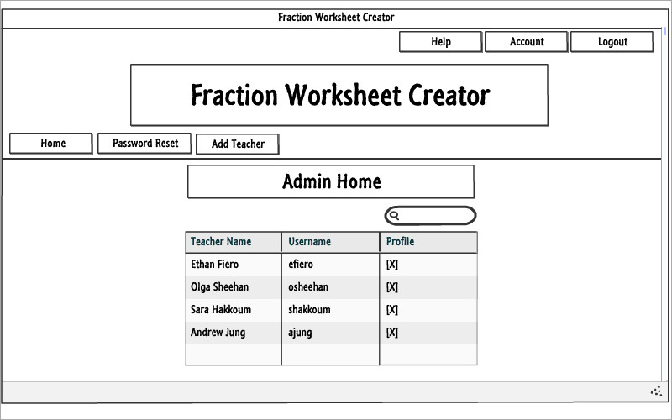
ADMIN HOME

Slide 7
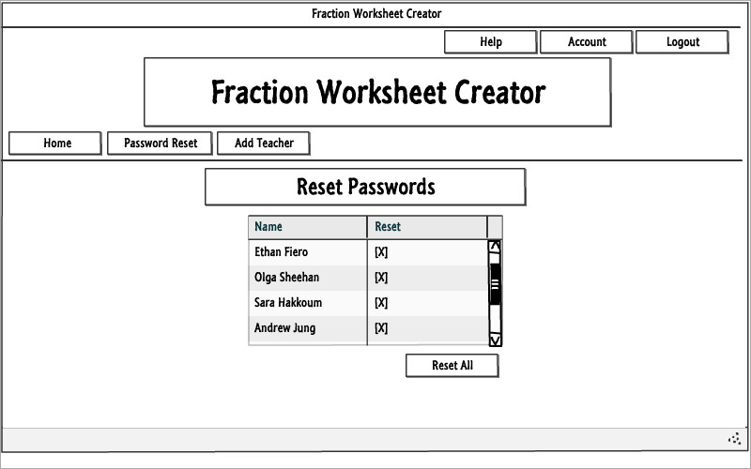
Admin - RESET PASSWORDS

Slide 8
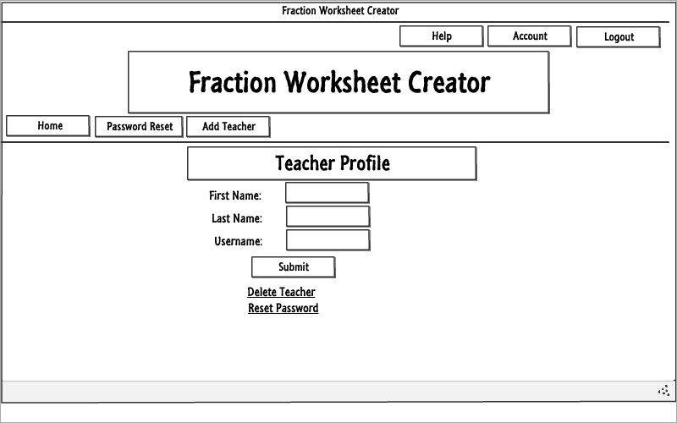
AdMin - Teacher Profile

Slide 9
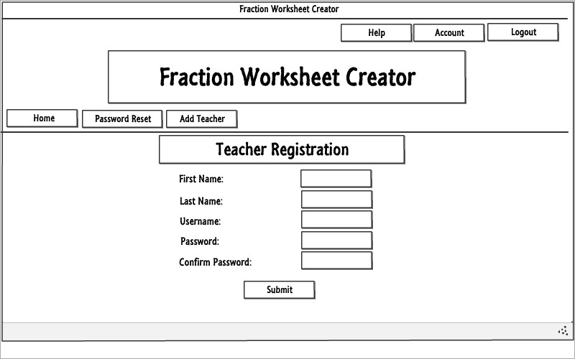
Teacher registration

Slide 10
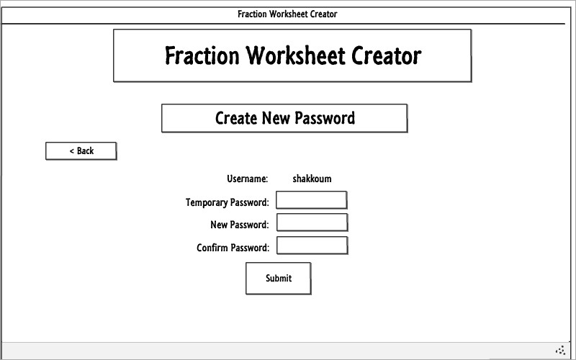
Teacher – force reset

Slide 11
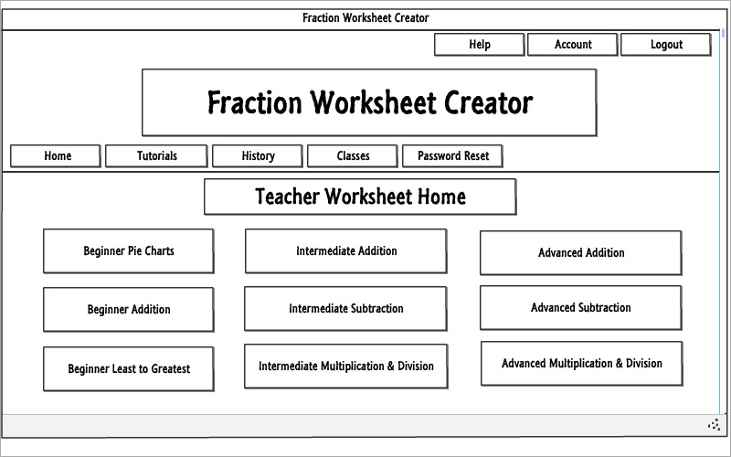
Teacher Home

Slide 12
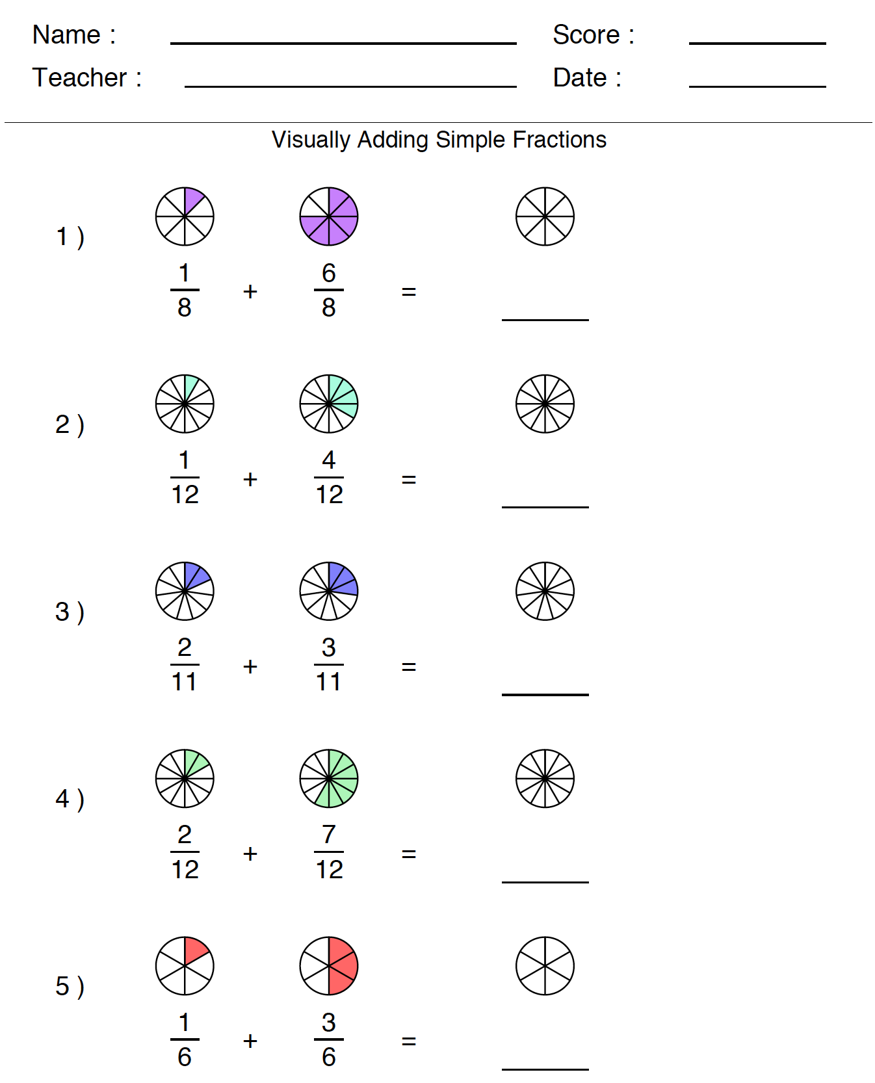
Example Worksheet

Slide 13
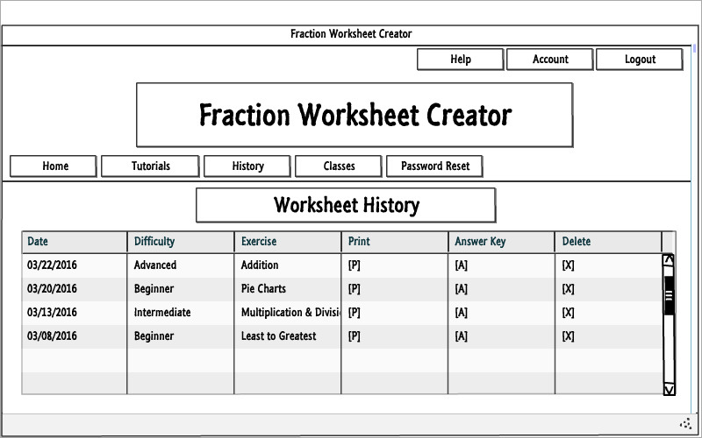
Teacher – Worksheet HIstory

Slide 14
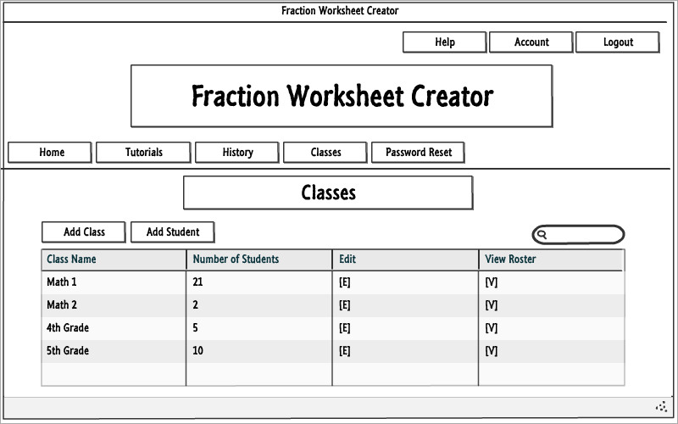
Teacher - Classes

Slide 15
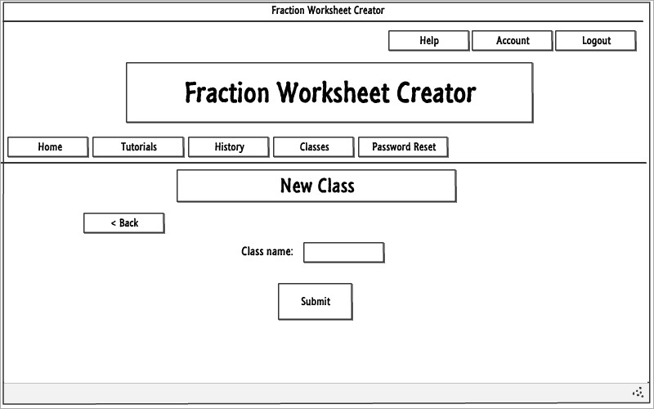
Teacher – Adding a New Class

Slide 16
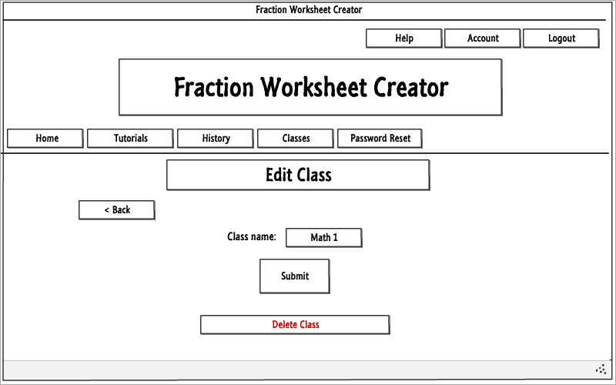
Teacher - Edit Class

Slide 17
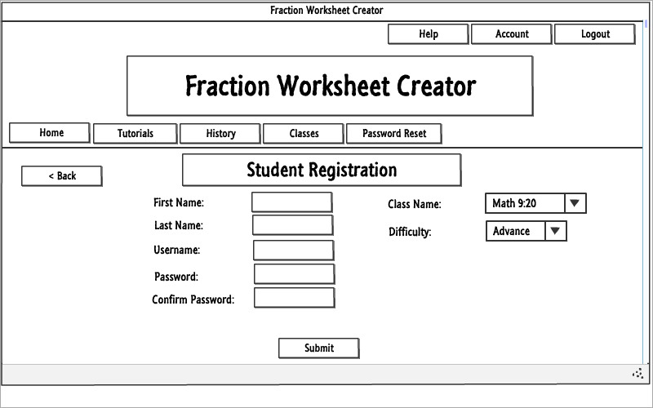
Student registration

Slide 18
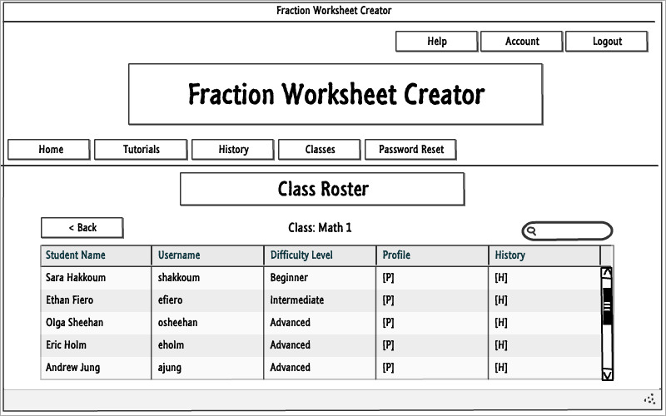
Teacher – class roster

Slide 19
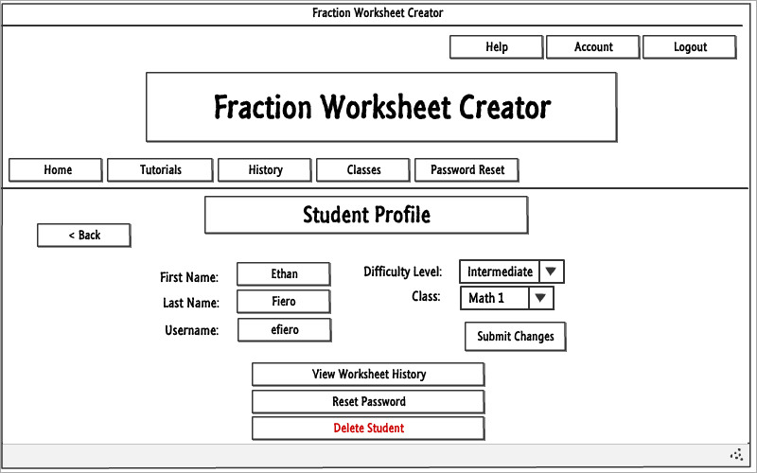
Teacher – student profile

Slide 20
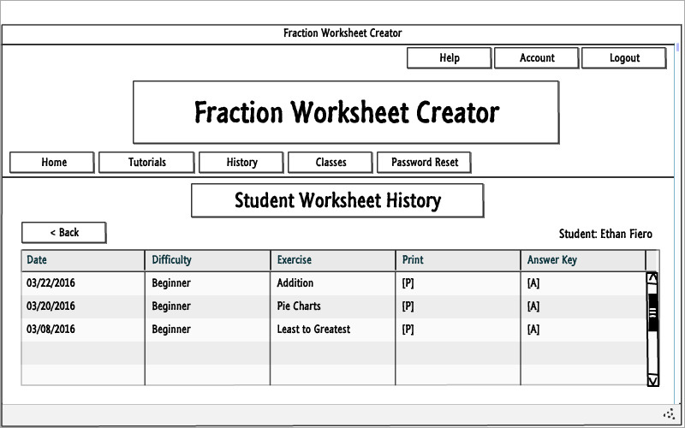
Teacher – Student Worksheet history

Slide 21
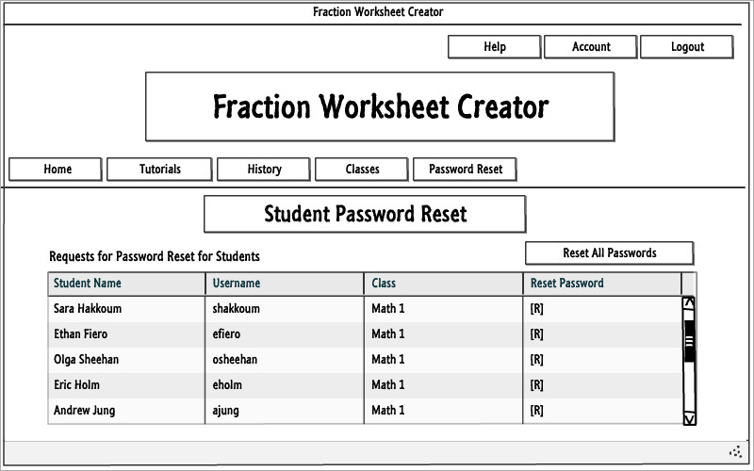
Teacher – Student Password reset

Slide 22
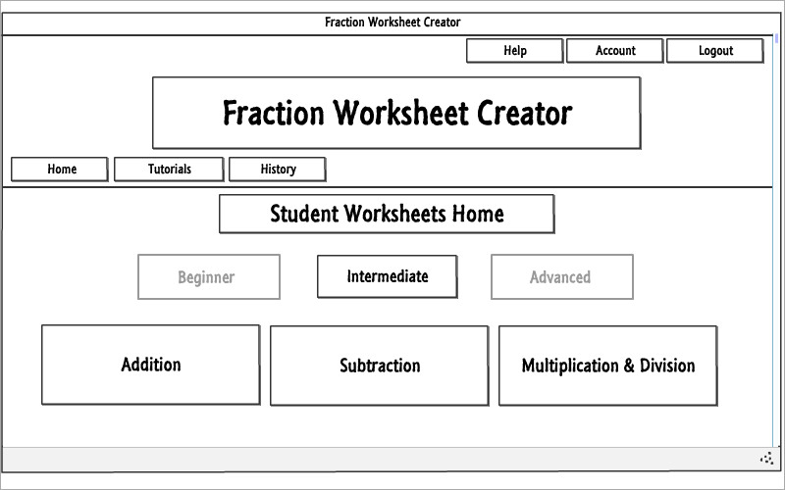
Student - home

Slide 23
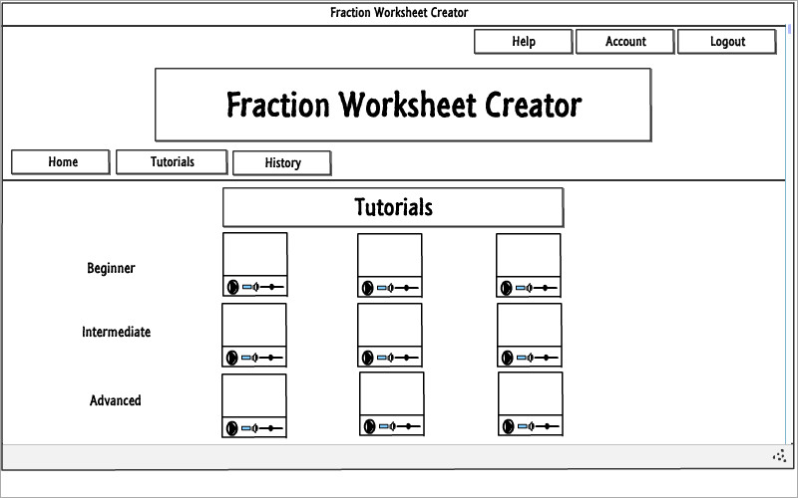
All users - tutorials

Slide 24
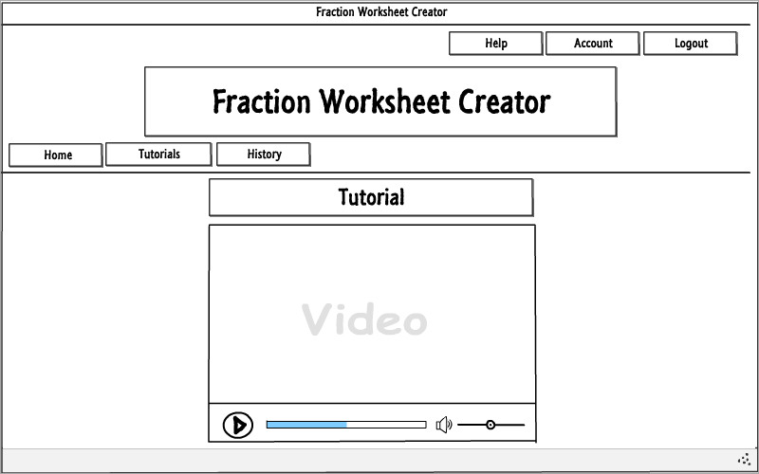
Single tutorial

Slide 25
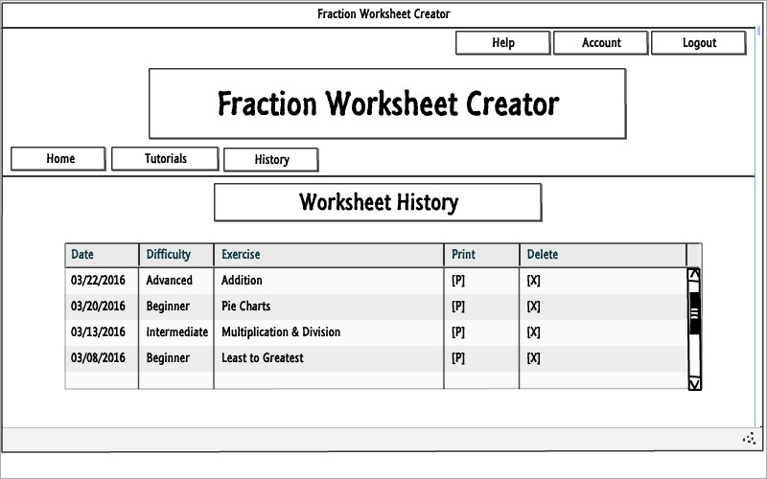
Student worksheet history

Slide 26
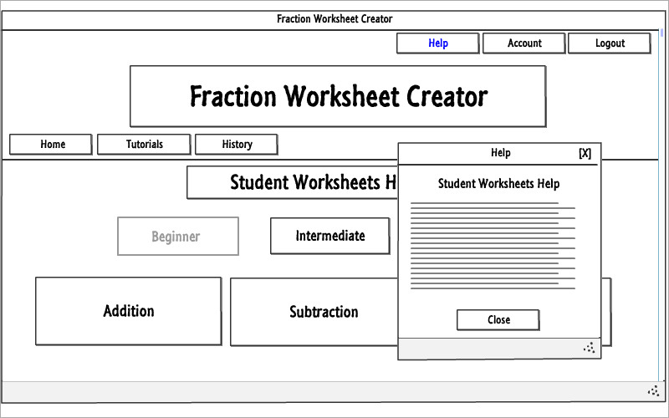
help

Slide 27
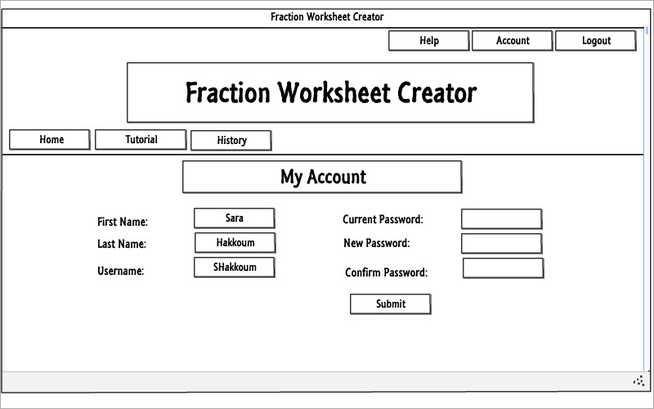
My Account

Slide 28
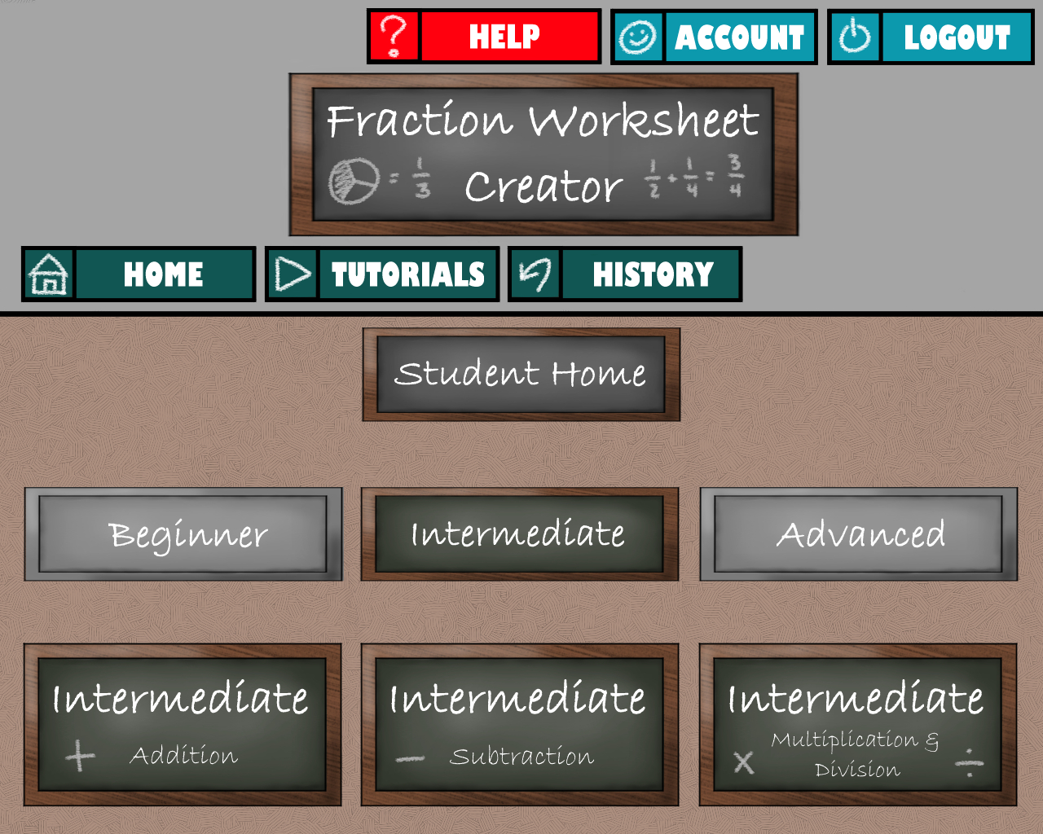
Graphical Mockup

Slide 29
Questions?

